Slide 1
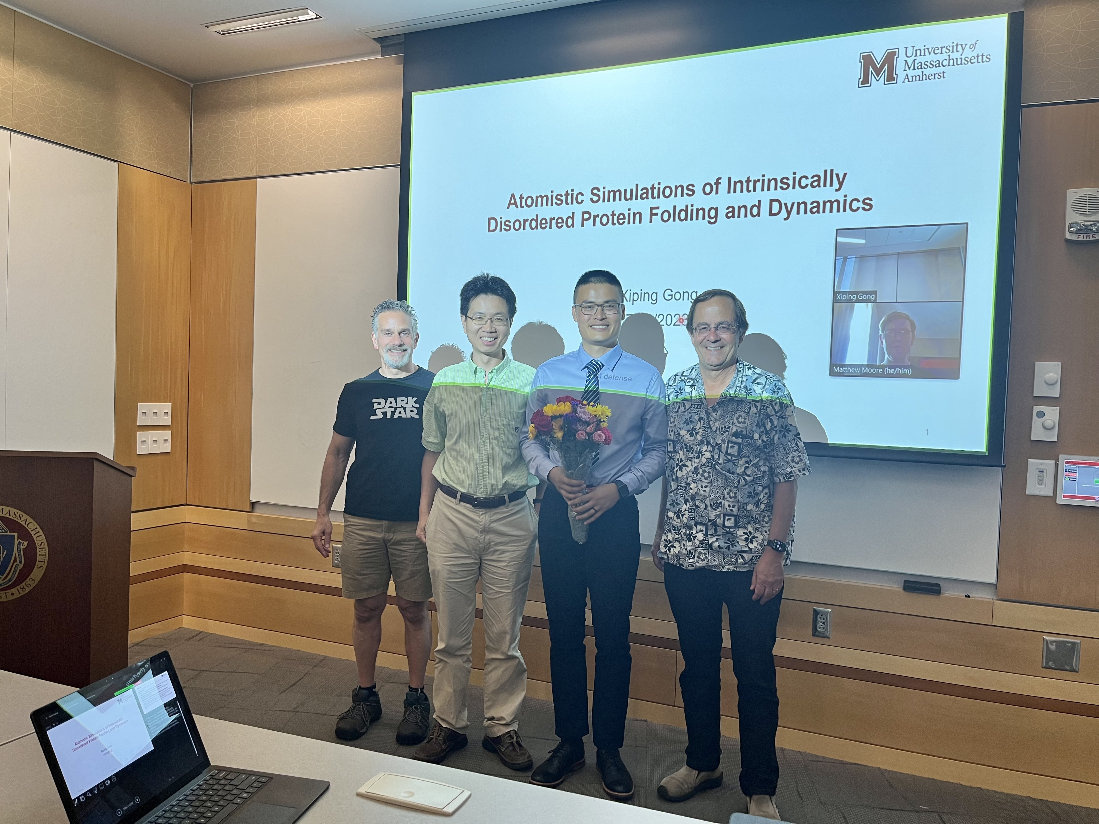

Slide 2
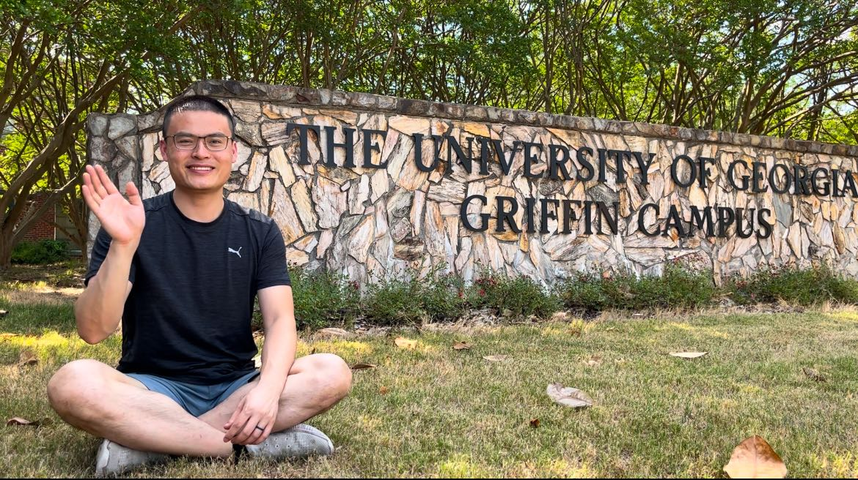

Slide 3
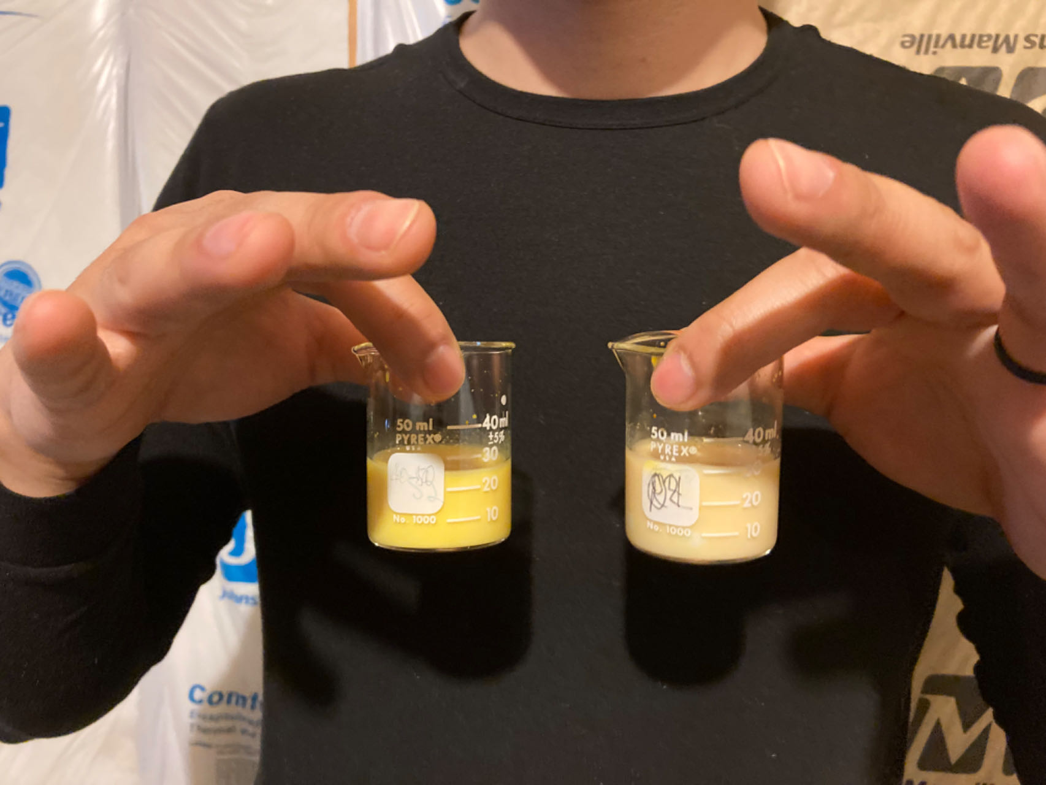
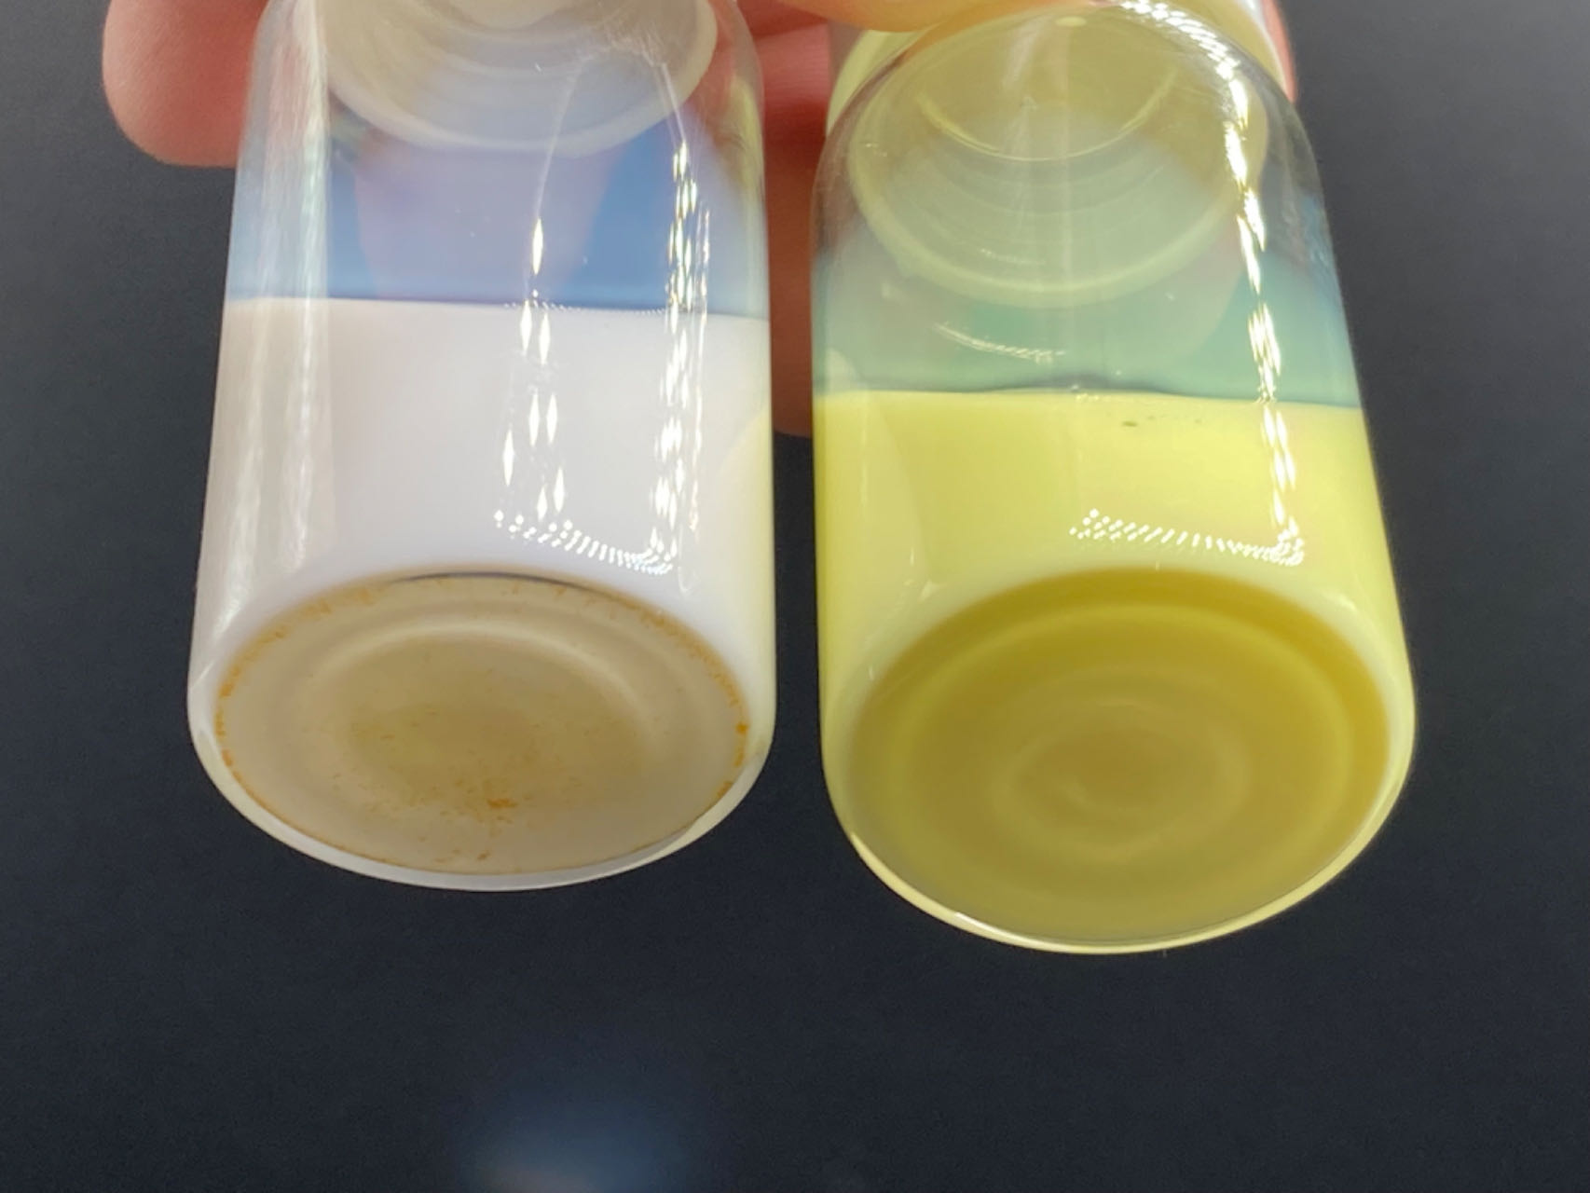
12/03/2023
Crystalline curcumin + Milk
pH-treated curcumin + Milk
This marks my first successful experiment in formulating curcumin-infused milk.

Slide 4
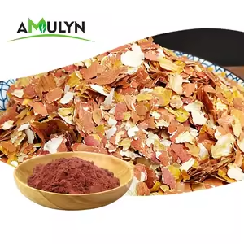
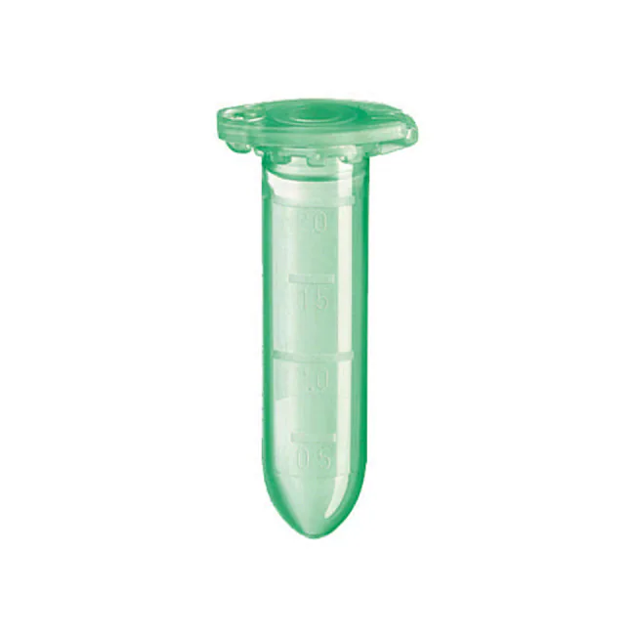
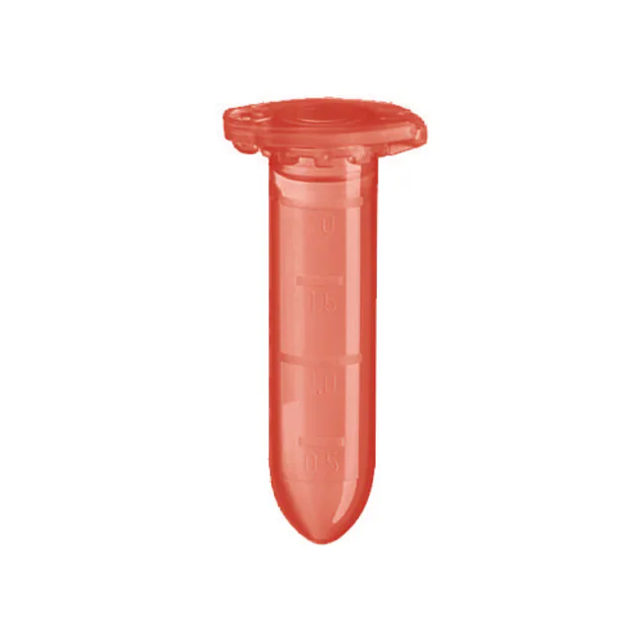
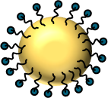

Alkali
Acid
1.8×
1×
1
2
3
Off
4
Post pH-driven (PPD) method for developing peanut skin-powered foods via an alkali-acid treatment

